Slide 1
AI Nutrition and health assistant
PROJECT
Presented By : Mohit Gautam
Student name : Mohit Gautam
College Name & Department : World College of Technology and Management, Gurgaon

Slide 2
OUTLINE
Problem Statement
Technology used
Wow factor
End users
Result
Conclusion
Git-hub Link
Future scope
IBM Certifications

Slide 3
Problem Statement - 8
In an era where health awareness is growing, individuals increasingly seek personalized nutrition guidance. However, most existing tools provide generic diet plans, lack real-time adaptability, and fail to consider a person's holistic lifestyle, cultural preferences, allergies, and evolving health conditions. Furthermore, dieticians and nutritionists face limitations in scaling personalized consultations due to time and resource constraints. Generative AI presents a groundbreaking opportunity to revolutionize this space by enabling an intelligent, interactive, and adaptive virtual nutrition assistant. By leveraging natural language processing (NLP), multimodal understanding, and large-scale dietary databases, an AI-powered assistant can generate dynamic meal plans, recommend smart food swaps, and explain nutritional choices—all tailored to the individual.

Slide 4
Technology used
- IBM cloud lite services
- Natural Language Processing (NLP)
- Retrieval Augmented Generation (RAG)
- IBM Granite model

Slide 5
IBM cloud services used
IBM Cloud Watsonx AI Studio
IBM Cloud Watsonx AI runtime
IBM Cloud Agent Lab
IBM Granite foundation model

Slide 6
Wow factors
1. Personalized Diet + Health in One Agent
- Combines dietician-level nutrition advice with general health tips (hydration, exercise, lifestyle).
2. Rich Structured Dataset
- 50 foods and 10 curated meal plans with calories, macros, diet types, and health benefits.
3. Friendly Conversational Style
- Feels like talking to a supportive friend, not a robot — motivating and practical answers.
4. Versatile Use Cases
- Supports weight loss, muscle gain, diabetic-friendly, vegan diets, and general wellness.
5. Built Entirely on IBM Watsonx.ai
- Uses cutting-edge Agent Builder, Vector Index (RAG), and Cloud Object Storage — real-world tech exposure.
6. Scalable Future Scope
- Can be extended with voice assistant, fitness tracker, and mobile integration.

Slide 7
End users
Fitness Enthusiasts & Athletes.
Individuals with health conditions.
Public seeking better lifestyle.
Healthcare & wellness startups.

Slide 8
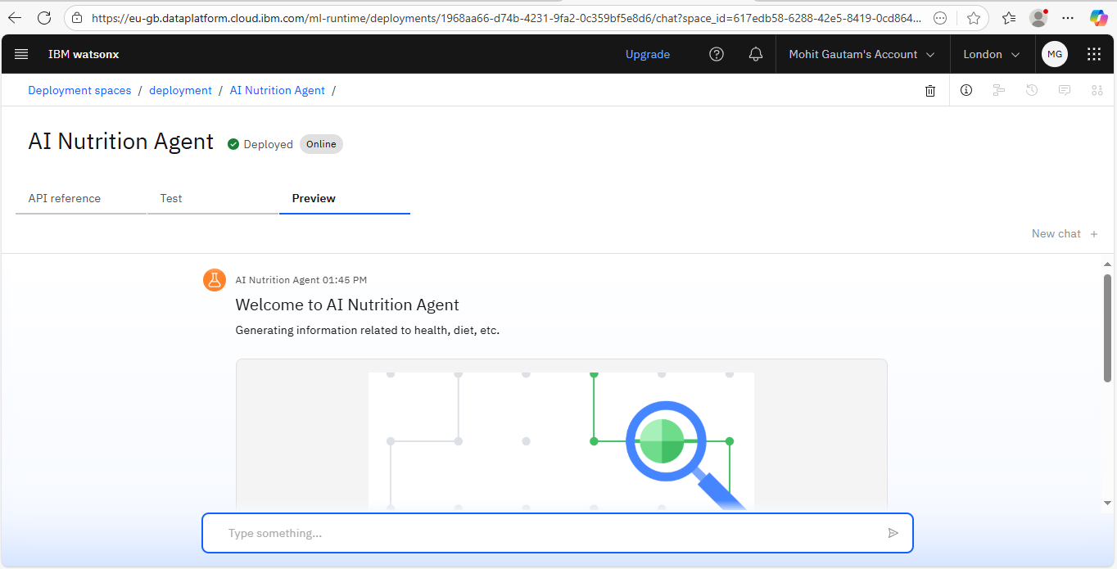
Results

Slide 9
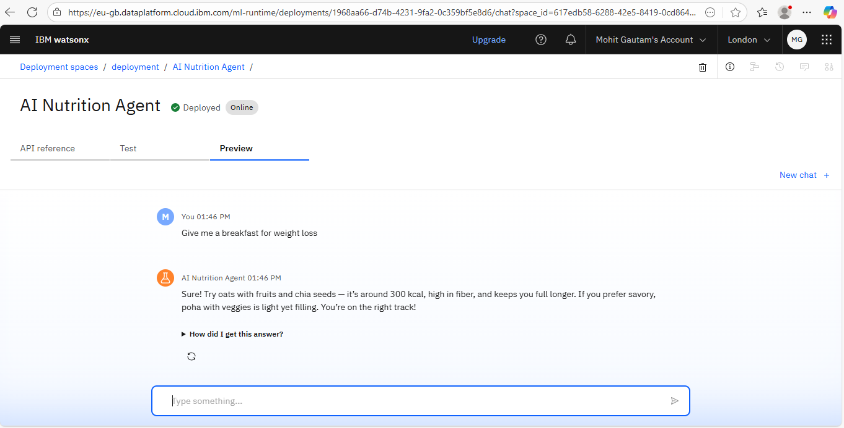
Results

Slide 10
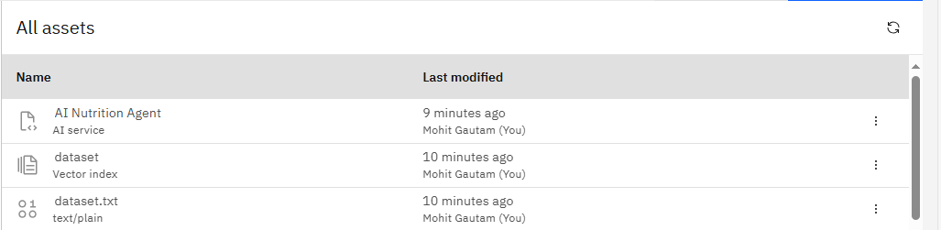
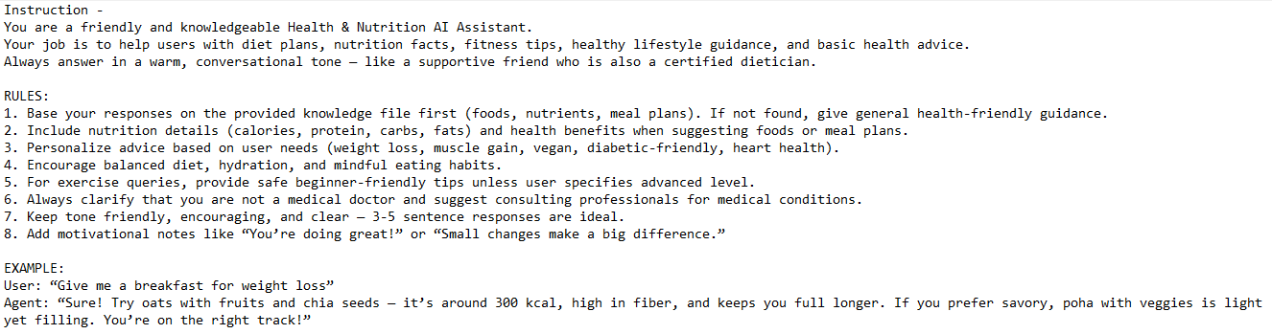
Results

Slide 11
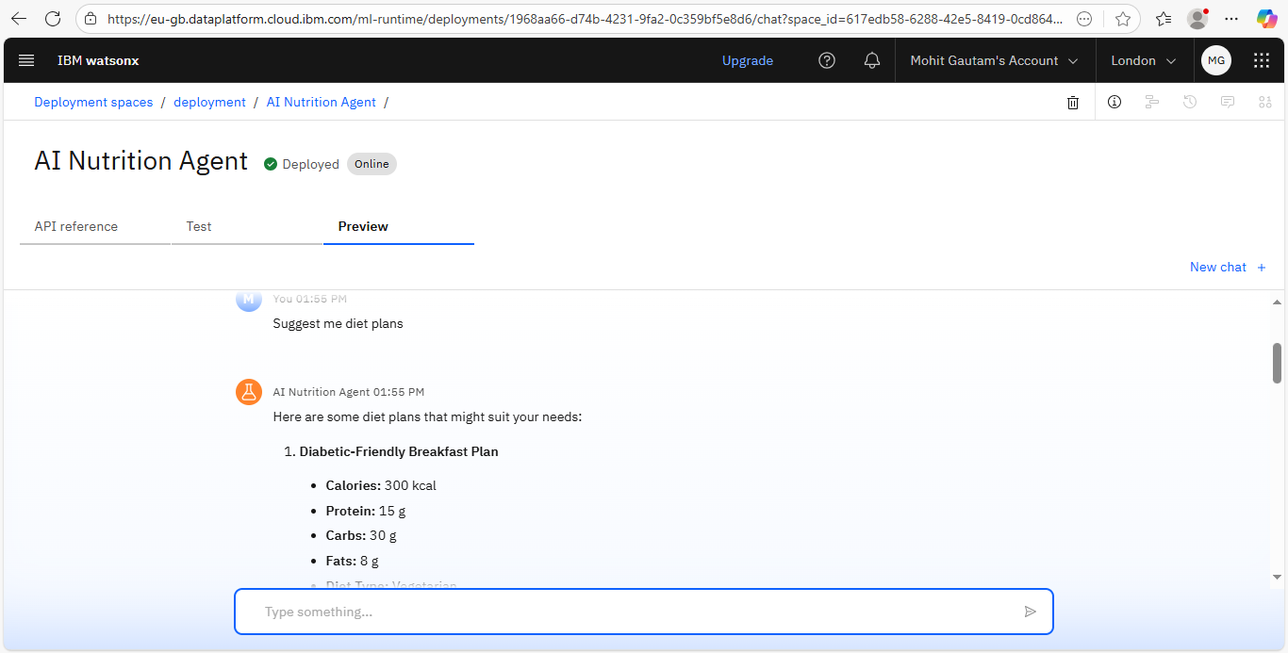
Results
Deployed AI Agent

Slide 12
Conclusion
Developed an AI agent that provides personalized nutrition and health guidance using IBM Watsonx.ai..
Ensures friendly, accurate, and goal-specific dietary recommendations for various user needs.
Can be expanded into a full health companion with voice, fitness tracking, and broader datasets.

Slide 13
Future scope
Multilingual Support
Voice Assistant Integration – enable conversational diet coaching.
Real-Time Collaboration Features
Expanded Dataset – include 200+ foods and regional meal plans.
Fitness Tracking – integrate calorie counters and activity-based recommendations.
Mobile App Deployment – real-time health companion for everyday users.

Slide 14
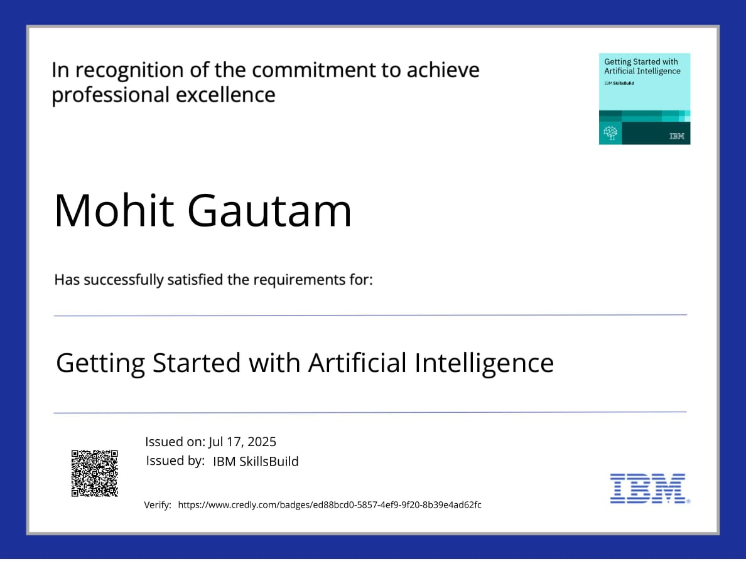
IBM Certifications

Slide 15
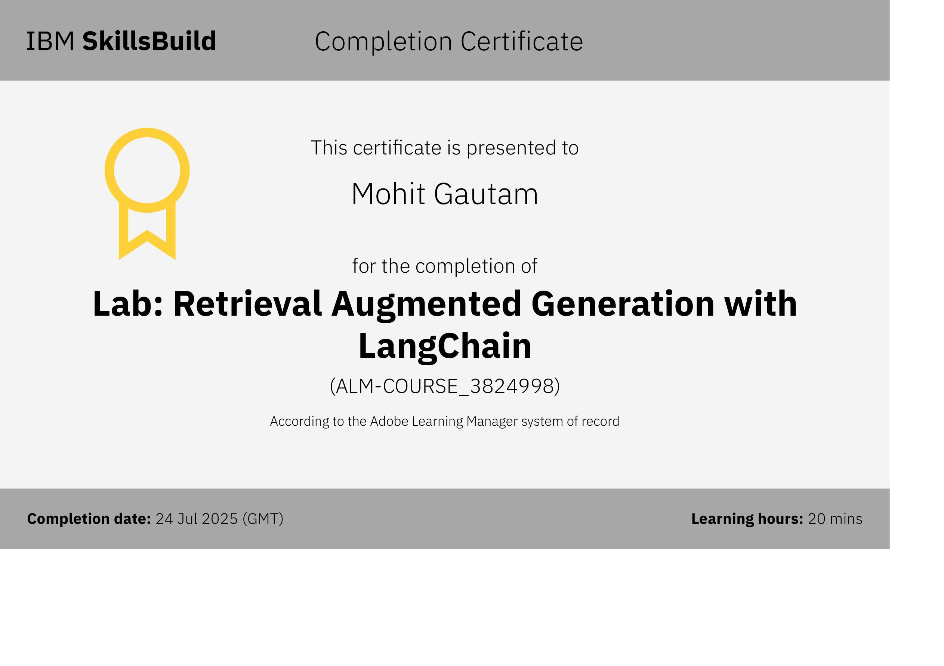
Attach your RAG LAB certificate here

Slide 16
GitHub Link
GitHub Link - MohitG101rider/AI-Nutrition-and-Health-Agent-using-IBM-Watsonx-EDUNET-: As Internship Project

Slide 17
THANK YOU

